Slide 1

The Physics of W
i-Fi

Slide 2
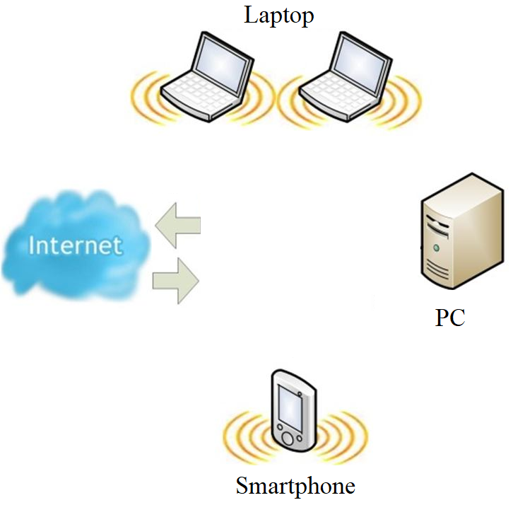
What is Wi-Fi
Wi-Fi is the wireless technology used to connect our devices to the internet, buy sending signal to router and vice versa Translating these signals into data you can see and use

Slide 3
How it Works
Now we know that Wi-Fi is possible through waves. These
waves are known as radio waves. These waves
transmit data by oscillating at different frequencies. These waves are necessary in why Wi-Fi works.
oscillate :move or swing back and forth in a regular rhythm.

Slide 4
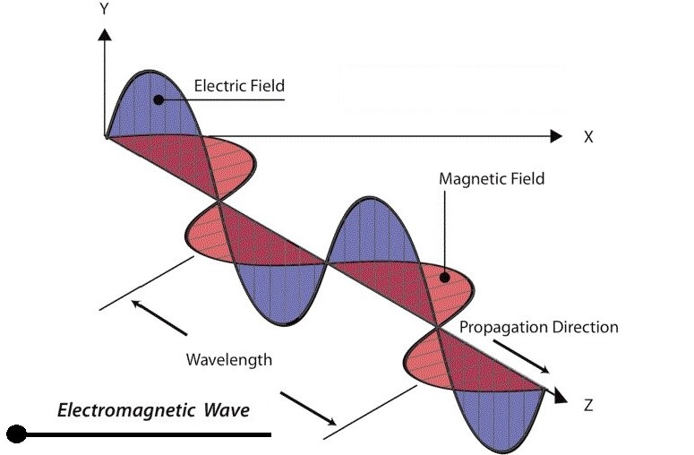
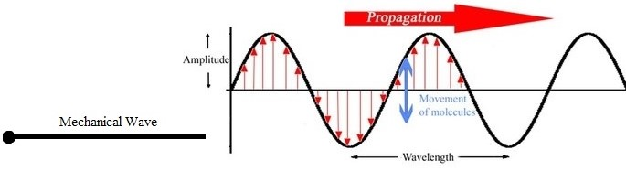
Type of Waves
Electromagnetic: Radio Wave, Micro-waves, Visible Light Rays.Ultraviolet Waves,X-rays,Gamma Rays.
Mechanical: Mechanical waves include water waves, sound waves, and waves on ropes or springs. Mechanical waves travel in a medium (such as air, water, glass, or rock).
amplitude :the maximum extent of a vibration or oscillation
propagating: increase in numbers. the spreading of something

Slide 5
How it Works
Waves travel at the speed of light, these waves moves at the speed of light which make data transfer fast. The only issue is how much data can be sent.
While 915 mhz is great at going long distances it is moving so slow it is not capable of transferring large amount of data in transmissions.
While the stand 2.4 Ghz is oscillating at a much greater speed it allows for more data to be transferred.
The major issues with radio waves is they reflect around. The faster the waves the easier they are reflected.
So the new 5.0GHZ waves are more prone to being jumbled up and because of this they often only perform better in smaller areas.

Slide 6
Now we can get into the important qualities of radio waves
and how they shape our world of Wi-Fi "..different radio
frequencies behave differently in different environments. The
higher the frequency, the more easily radio waves are
absorbed or reflected by things like ordinary building
materials and vegetation. Visible light, though far higher up
the electromagnetic spectrum, demonstrates the principle
nicely. A sheet of typing paper will let some light through, but
a ½ inch piece of plywood will block it entirely. Radio waves
behave in a similar fashion. They have much better
penetration than visible light, but you wouldn't bother trying
to pick up the Cubs game if you were working in a bank vault.

Slide 7
Because higher frequencies are more easily reflected, they
produce more multipath propagation, a phenomenon that
occurs when transmitted signals bounce off an intervening
object – even ordinary raindrops. The reflections cause
different parts of the signal to arrive at the receiver at different
times, and out of sequence. The worse the multipath
propagation becomes, the more the signal begins to merge
with the noise floor. " (automation.com) The issues with WIFİ
come down to the physics of radio waves. As the distance is
added to the waves the faster they oscillate the more prone
they are to what is called path loss. While with greater
frequencies we are able to transfer greater amounts of data.
That data can not travel as far It is balance between amount

Slide 8
Because higher frequencies are more easily reflected, they
produce more multipath propagation, a phenomenon that
occurs when transmitted signals bounce off an intervening
object – even ordinary raindrops. The reflections cause
different parts of the signal to arrive at the receiver at different
times, and out of sequence.

Slide 9
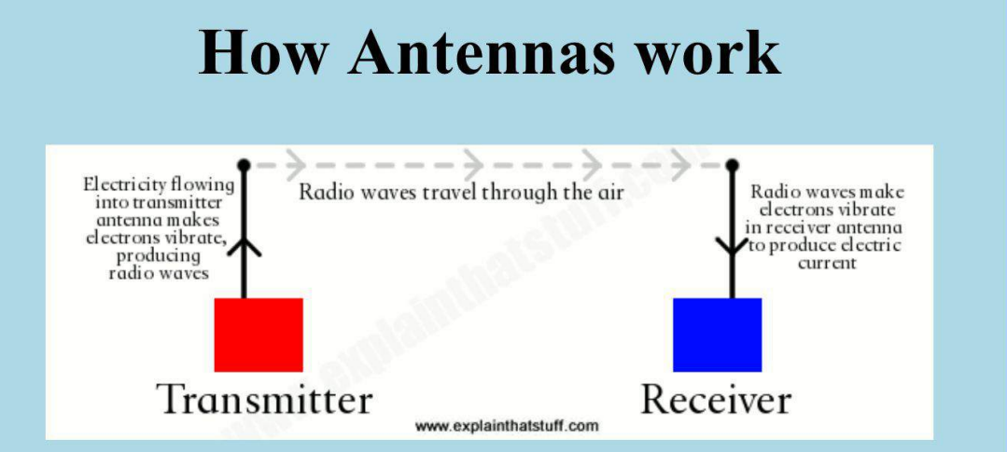
The worse the multipath propagation becomes, the more the signal begins to merge with the noise floor. " (automation.com) The issues with WI-FI come down to the physics of radio waves. As the distance is added to the waves the faster they oscillate the more prone they are to what is called path loss. While with greater frequencies we are able to transfer greater amounts of data. That data can not travel as far It is balance between amount by creating multiple sources of the signal to effectively cover an area with signal.

